Slide 1
TEAM BALAKUMAR RAHUL GEETAHARICHANDANA VEMURI SREEKAR ADUSUMILLI UPAMANYU MONDAL VENKATARAMANA PITTALA Department of Health Informatics, IU Luddy School of Informatics, Computing, and Engineering, IUPUI. Timothy Gruenhagen
The Outliers
IUPUI

Slide 2
Analysis of the relationship between user satisfaction and effectiveness using drug type as a factor

Slide 3
INTRODUCTION
This is our initiative to examine the efficacy and user satisfaction of prescription and over-the-counter medications used to treat prevalent medical illnesses. Patient satisfaction is a crucial element that can impact medication adherence and general health outcomes. By analyzing user ratings, our research aims to provide valuable insights to improve clinical judgment and enhance patient outcomes. Let's explore our findings and the importance of patient satisfaction in the healthcare industry.

Slide 4
DATA VARIABLES
The Drug Performance Evaluation Dataset was obtained from Kaggle. It contains drug performance characteristics for different types of drugs used to treat 37 common medical conditions. It has data on user satisfaction and effectiveness collected from patients. The dataset contains drug information, including medical conditions, names, indications, types, reviews, effectiveness, ease of use, and satisfaction.

Slide 5
METHODS

Slide 6
HYPOTHESIS
HYPOTHESIS
Our research question is: Does the type of drug (prescription and over-the-counter) have an impact on drug effectiveness and satisfaction?
Our null hypothesis is: There is no difference in drug effectiveness and satisfaction while using prescription and over-the-counter drugs.
Our alternative hypothesis is: There is a difference in drug effectiveness and satisfaction while using prescription and over-the-counter drugs.

Slide 7
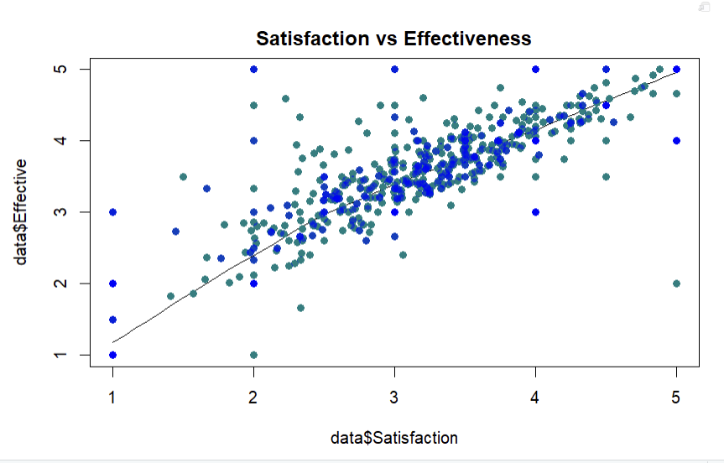
Data Cleaning and Organization:
We started by coding the "Types" column using R, and checked for duplicates and blank values and there were none.
Exploratory Data Analysis:
To understand the data, we used scatter plots to visualize the relationship between Satisfaction and Effectiveness.

Slide 8
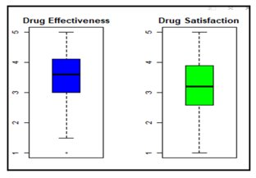
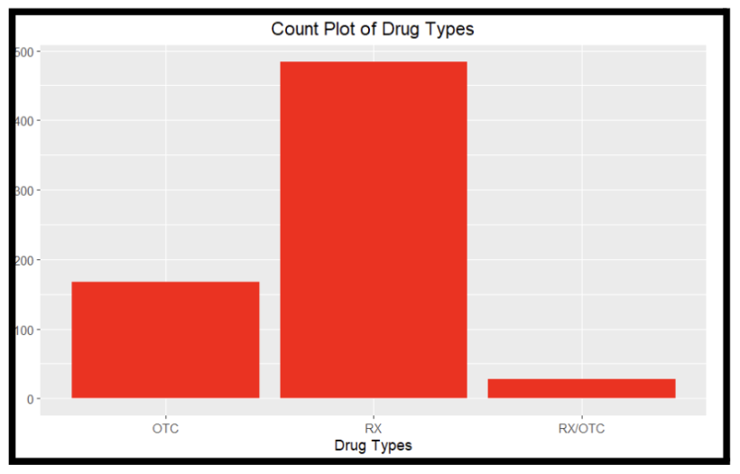
Box plots to check for the distribution of these variables.
Count plot to see the distribution of the drug types.

Slide 9
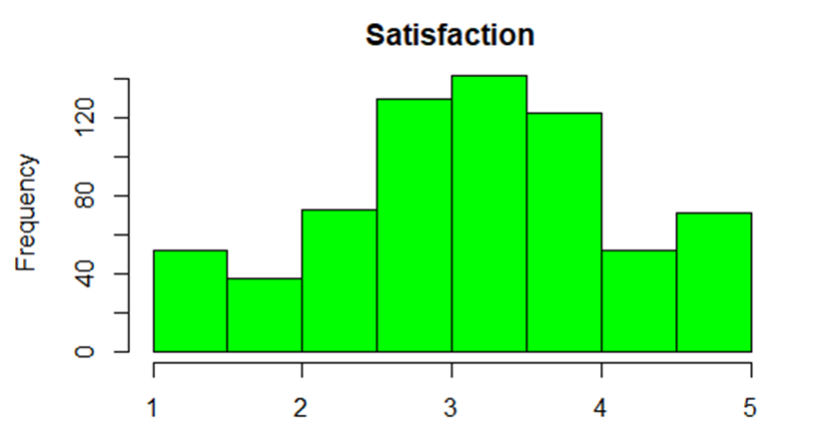
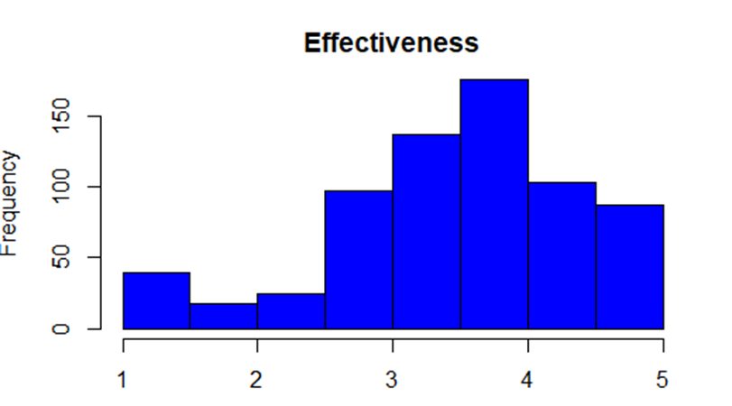
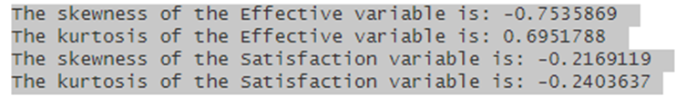
Histograms and count plots to explore the distribution of Satisfaction and Effectiveness.

Slide 10
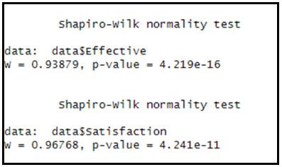
Checking Data Distribution:
Used histograms to check the distribution of effectiveness and satisfaction and a count plot for the types of drugs. Most of the drugs are prescription drugs, followed by over-the-counter drugs, and only a few are RX/OTC sold both as prescription and over-the-counter.
Shapiro-Wilk:
Carried out the Shapiro-Wilk Test to check for normality. Since the p-value we deduced happened to be extremely small (less than 0.05), it suggests strong evidence to reject the null hypothesis of normality. Therefore, both the values "Effective" variable and “Satisfaction” is likely not normally distributed.

Slide 11
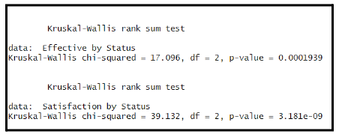
Kruskal-Wallis
Used the Kruskal-Wallis test to determine any significant differences between two or more groups. As the p-value was well below 0.05, we had sufficient evidence to reject the Null hypothesis and acknowledge that there were differences in effectiveness and satisfaction levels.

Slide 12
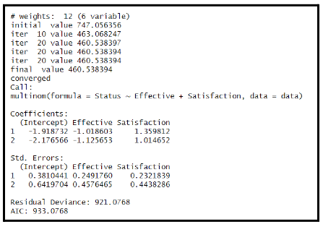
Built a multinomial logistic regression model to examine the relationship between one categorical response variable (status) with two continuous predictor variables (Effective and Satisfaction). The coefficients section shows the estimated coefficients for each individual predictor variable. The lower the residual deviance and AIC values, the better the fit of the model to the data.

Slide 13
LIMITATIONS

Slide 14
Every analysis has its limits, and ours is no exception.
We have identified several areas where our approach may fall short in providing a complete understanding of the data.

Slide 15
One limitation is the sample size. Our dataset may not be large enough to provide a representative sample of the general population, which could limit the generalizability of our findings.
Furthermore, while we used a multinomial logistic regression model, this method is limited in its ability to handle multiclass variables that have a natural ordering to them. This could potentially impact the accuracy of our results and limit our ability to draw strong conclusions.
Additionally, like any analysis, our approach is subject to data entry and coding errors. While we took steps to minimize these errors, they cannot be entirely eliminated and may impact the accuracy of our results.

Slide 16
CONCLUSION

Slide 17
In conclusion, this study provides valuable insights into the usage patterns of prescription and OTC drugs in modern society.
The findings highlight the importance of understanding the effectiveness and satisfaction levels of drugs, as well as the significant differences in user experiences between prescription, OTC, and combination drugs.
While there were some limitations to our approach, the statistical methods used proved to be effective in analyzing the dataset. As healthcare continues to evolve, it is essential to have a better understanding of how people use drugs and their experiences with them. This study contributes to that understanding and may inform future research and clinical practices in this field.

Slide 18
THANK YOU

